Slide 1
Group 15
Improving Efficiency of Reconciliation
Implementation using blockchain to provide a solution to the problem of data loss and corruption.
Vidhyanshu Jain Abhinav Rituraj Guneet Kher Aditya Kola

Slide 2
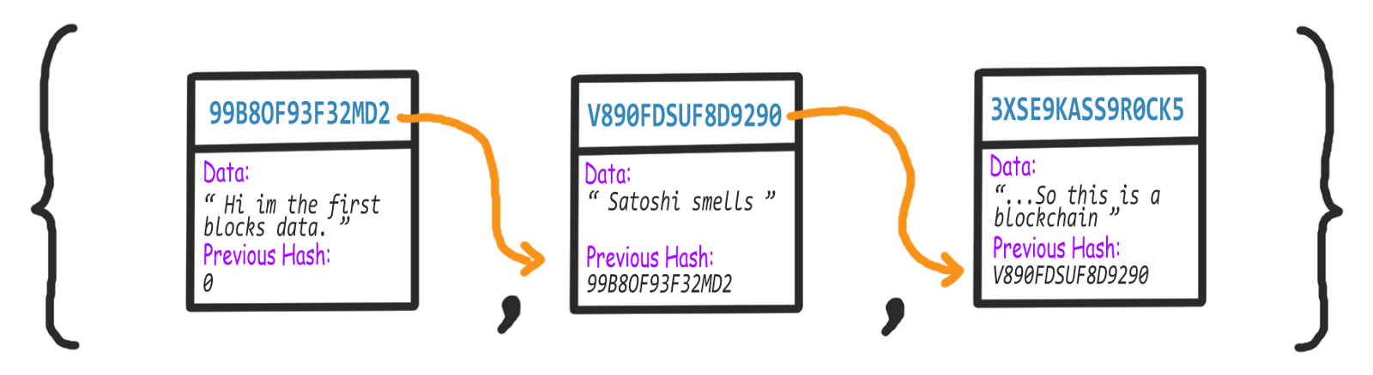
Ethereum
Secure Trusted Transparent
Hash Value from File
Immutable
Proof of Work

Slide 3
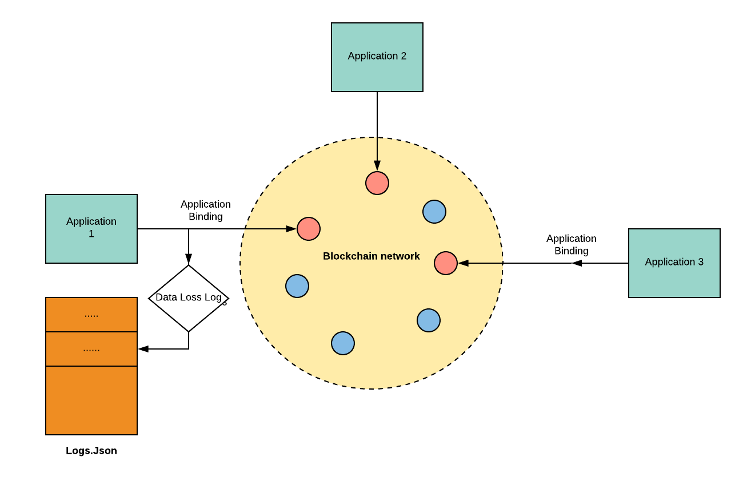
Architectural Diagram

Slide 4
Future Scope
Detection of loss on the receiver end.
Enterprise Friendly

